Slide 1

Open Electrical Grid Model for Regional Transmission Networks PESS & PELS 2022, 2nd – 4th November, Kassel, Germany Session Grid Planning
Notes:
Vortrag im Modul SNEE
Beschäftigen uns als erstes Team mit der Elektrifizierung der Wärmeversorgung
Den Untersuchungsgegenstand stellt das Innenstadtnetz der Stadt Bad Neuenahr dar

Slide 2
Agenda
osmTGmod
3
START
Motivation
2
Open Street Map
1
Methodology
Outlook
END
4
5
Conclusion
6

Slide 3




Motivation
Simulation of power flow
➔ Electrical grid models are needed
Missing grid models in the global south
Generation of grid Models based on geographic data
Open-Source Project
Decentralization of generation of electricity
Notes:
Hierzu zwei Fragestellungen erarbeitet:
Da es sich um Bestand handelt (nicht nur Gebäude, sondern auch bestehendes elektrisches Netz), ist es besonders interessant, ob dieses ausreichend dimensioniert ist, wenn die Einbringung von WP sukzessive erhöht wird
2. Fragestellung zielt auf mögliche Optimierungsmaßnahmen ab

Slide 4
osmTGmod
Developed by the Wuppertal Institute
osmTGmod
Load-flow model of the german transmission grid
Uses PostgreSQL, PostGIS, SQL, pl/pqSQL and Python
Long computing time and non state-of-the-art software
This tool presented here is based on osmTGmod and has the goal to use only one programming environment / software

Slide 5
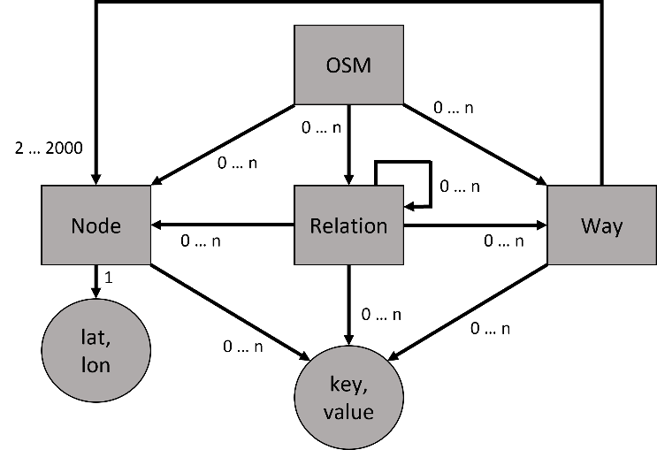
Open Street Map
Nodes: composed of a set of coordinates, represent point objects
Ways: represent line objects and connect Nodes
Relations: represent correlation between different objects
Key-Value pairs: called a Tag. Each tag defines the property an object
Notes:
Biggest open-source geodatabase worldwide
Everyone can contribute with their input by adding or adapting information

Slide 6
Open Street Map
power poles are declared as Nodes
Overhead cables are integrated as Ways
Key-Value pair
power = line
power = cable
Notes:
Biggest open-source geodatabase worldwide
Everyone can contribute with their input by adding or adapting information

Slide 7
OSM-Filter - Theory
Electrical Compo-nents
Streets
Bus Lines
Electrical Components
Notes:
Not only electrical components are downloaded in OSM
Filter out non electrical components

Slide 8
OSM-Filter - Review
Decision Criteria | ESY-OSM-FILTER | PYROSM | OSM-NX | PYOSMIUM | OSM2-PSQL | OSM-FILTER
Documentation | + | + | + | + | + | +
Availability | + | + | + | + | + | +
Usage | + |  | -
Performance | + | + | -
Software | + | + | + | + | - | -
License |  | + | + | +
Input-File | + | + | + | + | + | +
Output-File | - |  |  | +
Activity | - | + | - | + | + | +
Notes:
Not only electrical components are downloaded in OSM
Filter out non electrical components

Slide 9

OSM-Filter - Application
Objects of the class Relation with the value “power” for the tag “route” are saved as a Python tuple object.
Objects of the class Ways with the tag “power” or if the Way object can be found in the before saved list of Relations. Also, all Nodes listed in this Way object are saved.
Objects of the class Nodes are considered. Here, only the Nodes are needed, that are part of the Node tuple created in the second iteration.
Problem: A large amount of the data is incomplete and inconsistent
1
2
3

Slide 10


Python Script - Theory
Read in the generated CSV-Data as Pandas DataFrame and partly split it up
For example, the Ways table is separated in substations and lines/cables
Adjustment of the data of the respective tags
Therefore, the data types of same values are unified
Missing data can be added and errors can be removed

Slide 11
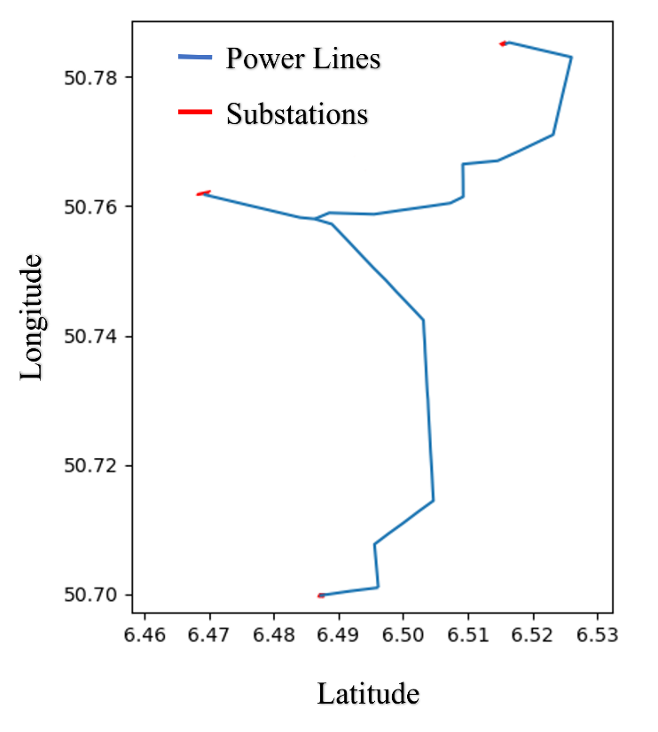
Python Script - Application
Table before adaption
id | voltage | frequency | cables
1114389452 | 380000; 110000 | 50 | 12
Tables after adaption
id | voltage | frequency | cables
1114389452 | “380000, 110000” | “50, 50” | “6, 6”

Slide 12
Outlook
Not all missing data has been populated yes
Not all components are connected or interlinked
Grid calculations and routing of power has not been realized
These are the next steps

Slide 13



Conclusion
Data and input of the tool is publicly available and used globally
Through the use of only Python, the tool can be replicated easily
Filter and part of the Power Script has been implemented
Rest of the Power Script has to be implemented

Slide 14

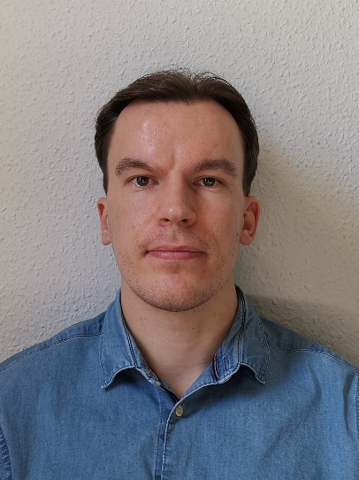
Contact
Jan Schmitt
Facutly of Plant, Energy and Machine Systems
TH Köln University of Applied Sciences
Gustav-Heinemann-Ufer 54
50968 Köln, Germany
E-Mail: jan.schmitt@smail.th-koeln.de
Derk Gonschor
Facutly of Plant, Energy and Machine Systems
TH Köln University of Applied Sciences
Gustav-Heinemann-Ufer 54
50968 Köln, Germany
E-Mail: derk.gonschor@smail.th-koeln.de
Alion Alushi
Facutly of Plant, Energy and Machine Systems
TH Köln University of Applied Sciences
Gustav-Heinemann-Ufer 54
50968 Köln, Germany
E-Mail: alion.alushi@smail.th-koeln.de

Slide 15

thank you for you attention

Slide 16
Motivation
Decentralization of generation of electricity
Simulation of power flow
➔ Electrical grid Models are needed
Missing grid Models in the global South
Generation of grid Models Based on geographic Data
Open-Source Project (availability)
Notes:
Zunächst möchte ich hierzu aktuelle Trends aufgreifen
Zu erkennen ist links der steigende Anteil erneuerbarer Energien an der Stromerzeugung und rechts der steigende Anteil an Wärmepumpenzubau im Neubau
In Kombination bilden diese beiden Diagramme das Potenzial der emissionsfreien Wärmeversorgung ab:
Immer mehr WP
Die durch Immer mehr Strom aus EE betrieben werden
Genau das ist auch der Fokus unserer Projektarbeit gewesen
„Elektrifizierung der Wärmeversorgung durch Einbringung von Wärmepumpen“

Slide 17
Theory of the Python Script
1. Read in the generated CSV-Data as Pandas DataFrame and partly split it up. For example, the ways Table is separated in substations and lines/cables.
2. Adjustment of the data of the respective tags. Therefore, the data types of same values are unified.
3. Missing data can be added and errors can be removed

Slide 18


Methodology
Open Street
Map
Filter
Python Script
Outlook
Conclusion
Notes:
Methodik entwickelt, um diese Fragestellungen auch beantworten zu können:
Untersuchung der Ausgangssituation, also der Netzpläne die uns zur Verfügung gestellt wurden
Daraufhin erfolgt einerseits Festlegung der elektrischen Lasten, die auch ohne Wärmepumpen anliegen
Und andererseits Festlegung der thermischen Lasten, die durch die Wärmepumpen abgedeckt werden sollen
Darauf aufbauend erfolgt die Simulation verschiedener Ausbauszenarien
Untersuchung der Ergebnisse

Slide 19




Methodology
Filter
Python Script
Outlook
Conclusion
Biggest open-source geodatabase worldwide
Everyone can contribute with their input by adding or adapting information
Open Street
Map
Notes:
Schritt: die Ausgangssituation
Übertragung aller relevanten Komponenten (Trafo, Leitungen, Knoten- und Anschlusspunkte)
Implementierung in PP

Slide 20

Methodology
Python Script
Outlook
Concusion
Open Street
Map
Not only electrical components are downloaded in OSM
Filter out non electrical components
Filter
Notes:
Festlegung der elektrischen Lasten und der Zuordnung der Gebäudetypen

Slide 21
Theory and application of the Filter
Filtering of OSM Data in 3 Steps:
1. Objects of the class Relation with the value “power” for the tag “route” are saved as a Python tuple object.
2. Objects of the class Ways with the tag “power” or if the Way object can be found in the before saved list of Relations. Also, all Nodes listed in this Way object are saved.
3. Objects of the class Nodes are considered. Here, only the Nodes are needed, that are part of the Node tuple created in the second iteration.

Slide 22
Methodology
Open Street
Map
Filter
Outlook
Conclusion
Python Script

Slide 23
Methodology
Open Street
Map
Filter
Python Script
Conclusion
Outlook

Slide 24
Methodology
Filter
Python Script
Outlook
Open Street
Map
Conclusion

Slide 25
Outlook
Not all missing data has been populated yet
Therefore not all components are connected or interlinked
Grid calculations and routing of power circuits can not be realized
These are the next steps

